Slide 1
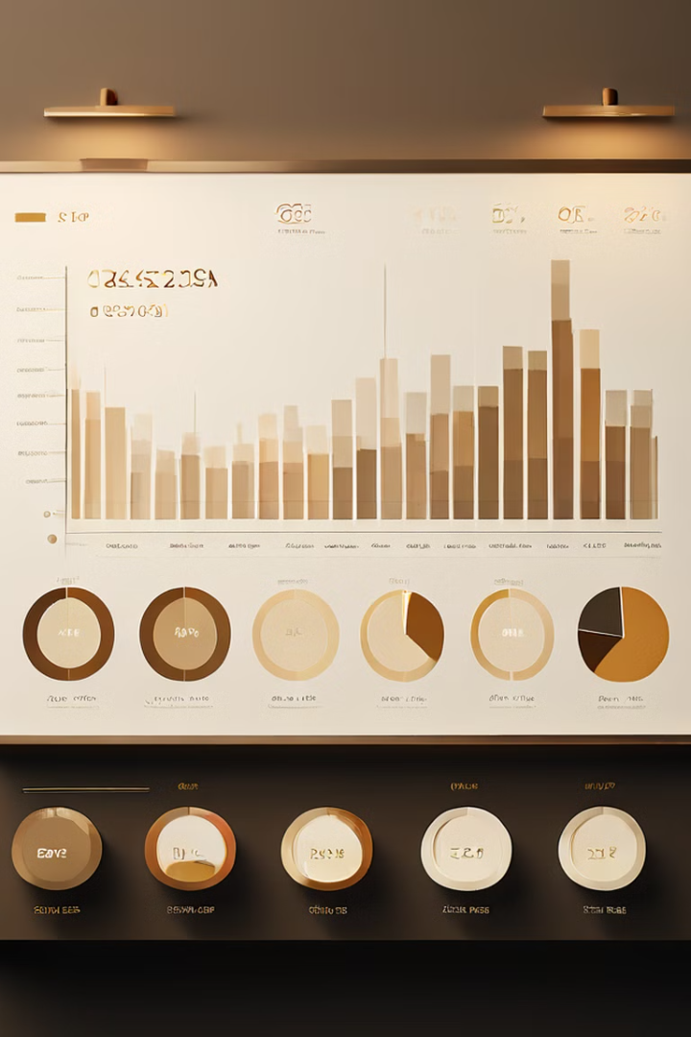

Financial Analytics
Explore our financial analytics dashboard to gain valuable insights about your industry. Analyze key metrics, track company performance, and make informed decisions to excel in the market.

Slide 2
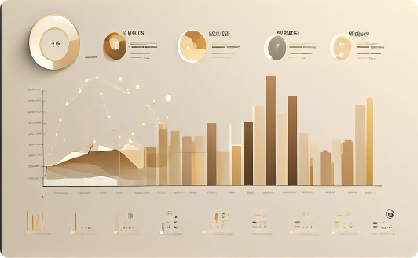


Unlock Valuable Industry Insights
Powerful Analytics
Visualize Key Metrics
Uncover Advantages
Leverage this Financial Analytics Dashboard to gain critical insights and drive strategic decision-making.
Explore and uncover the most important metrics to propel your organization forward.
Identify competitive advantages and make informed strategic decisions.

Slide 3
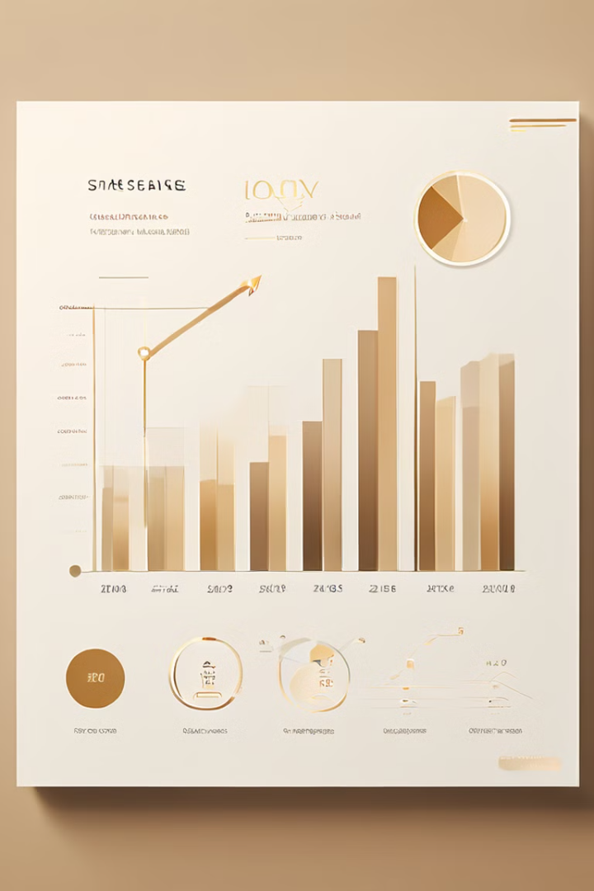
Key Metrics
Metric
Description
Mar Cap - Crore
Market capitalization in Crore
Sales Qtr - Crore
Sales for the quarter in Crore
Sum of Mar Cap - Crore
Total market capitalization in Crore
Sum of S.No.
Total number of companies
Sum of Sales Qtr - Crore
Total sales for the quarter in Crore
Total_Companies
Total number of companies
Total_Market_...
Total market capitalization

Slide 4
Market Cap and Sales Quantity Correlation
Correlation Analysis
Data Interpretation
This visualization displays the correlation between market capitalization and sales quantity. The scatter plot reveals the relationship between these two key financial metrics, providing insights into how market cap is influenced by sales performance.
By analyzing the scatter plot, we can identify trends and patterns in the data. For example, we might observe a positive correlation, indicating that companies with higher sales tend to have higher market capitalization. This analysis can be valuable for understanding market dynamics and making informed investment decisions.

Slide 5

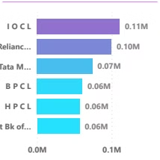
Top Companies by Sales Quantity
1
459 Total Companies
The dashboard analyzes a total of 459 companies, providing a comprehensive overview of the market.
2
Top Companies
The visualization highlights the top companies based on their sales quantity, showcasing the leading players in the market.
3
Power BI Desktop
The dashboard is powered by Power BI Desktop, a powerful data visualization and analysis tool that enables interactive exploration of financial data.

Slide 6
Top Companies by Market Cap
Market Cap
Sales
Top Companies
The dashboard displays the total market capitalization, which represents the combined value of all companies in the market.
The total sales figure represents the aggregate sales revenue generated by all companies in the market.
The visualization highlights the top companies based on their market capitalization, showcasing the most valuable companies in the market.

Slide 7

Company Performance
This visualization provides an in-depth analysis of key financial metrics for leading companies in the market. The scatter plot reveals the correlation between market capitalization and sales quantity, offering valuable insights into the performance and dynamics of these top industry players.
Name
Average of Market Cap
Average of Sales
3M India
23,101.19
645.77
A B B
31,983.33
2,779.40
Abbott India
11,924.12
881.49
ACC
30,803.68
3,494.24
Adani Enterp.
21,776.04
9,938.37
Adani Ports
81,781.89
2,688.85
Adani Power
12,091.50
4,844.46
Adani Transmissi
21,677.26
1,782.29
Aditya Bir. Fas.
11,718.17
1,855.00
Aditya Bir. Nuv.
24,592.21
4,287.12
Aditya Birla Cap
36,215.92
3,325.02
Total
13,251,777.13
1,747,775.34

Slide 8
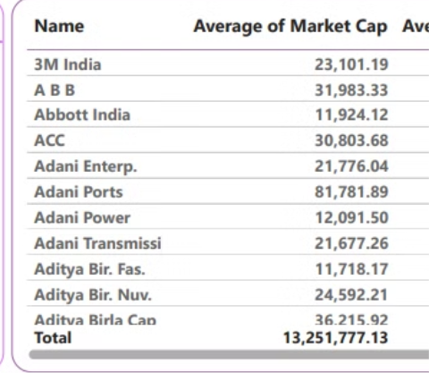
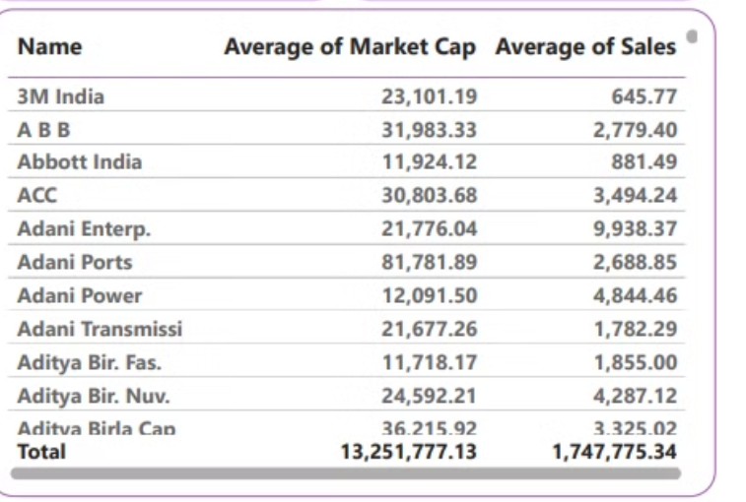
Company Performance Analysis
Average Market Cap
The dashboard provides the average market capitalization for each company, offering insights into their relative value and performance.
Average Sales
The average sales figure for each company reflects their average revenue generation over a specific period, indicating their financial health and market share.

Slide 9
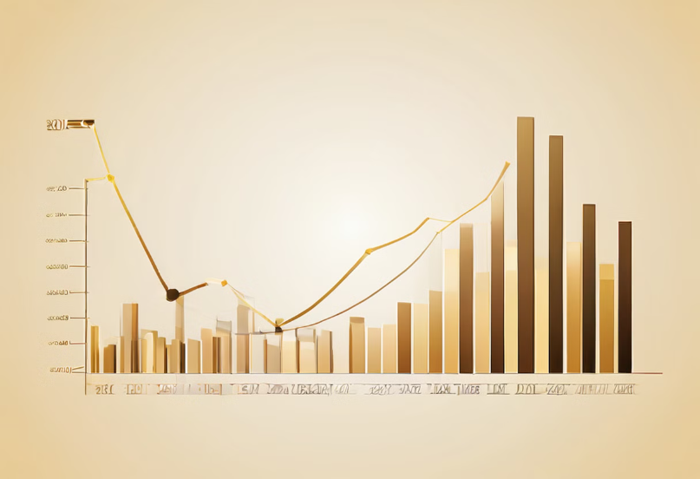
Market Overview
The total market capitalization is 13.25 million, representing the combined value of all companies in the market.
The total sales figure is 1.75 million, representing the aggregate sales revenue generated by all companies in the market.

Slide 10

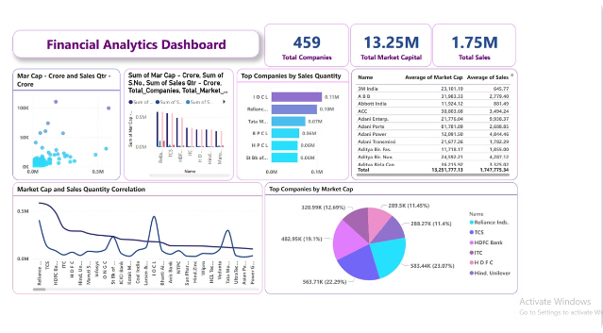
Company Details
This dashboard provides a comprehensive view of key financial metrics for each company, enabling in-depth analysis of their performance.
Get a detailed breakdown of each company's average market capitalization and average sales, empowering you to make informed business decisions.

Slide 11

Data Visualization and Analysis
The dashboard utilizes Power BI Desktop to visualize and analyze financial data, providing interactive insights and enabling users to explore data trends and patterns. This powerful tool empowers users to make informed decisions based on data-driven analysis.

Slide 12
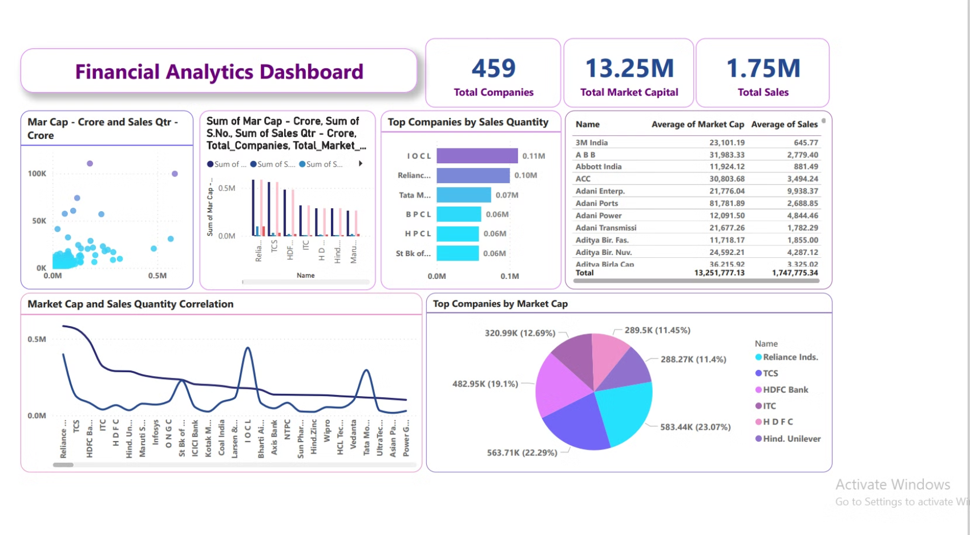

Slide 13

Thank You !

